Slide 1
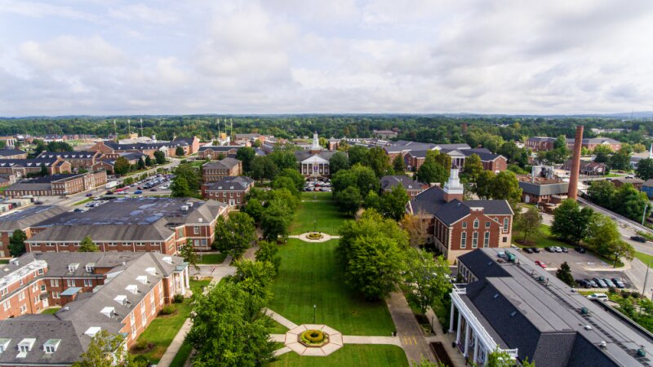

Lessons Learned Capstone Design
Meredith Nye

Slide 2
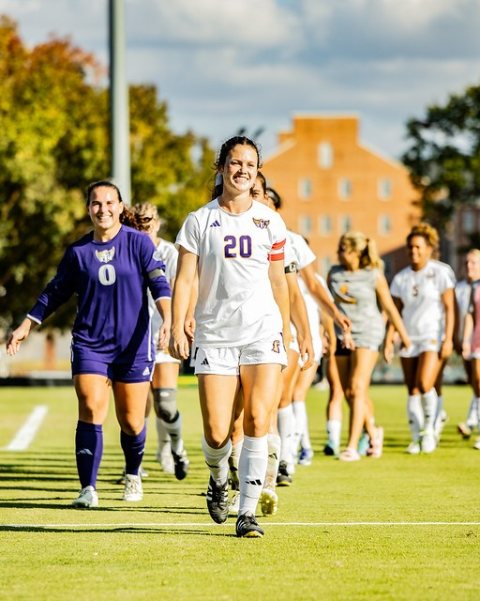
Overview
Who am I and what did I do?
Refection on the project experience.
What have I learned?
Words of wisdom.

Slide 3

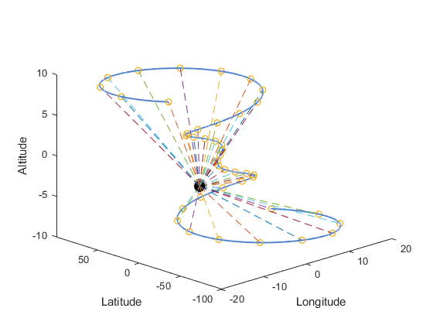
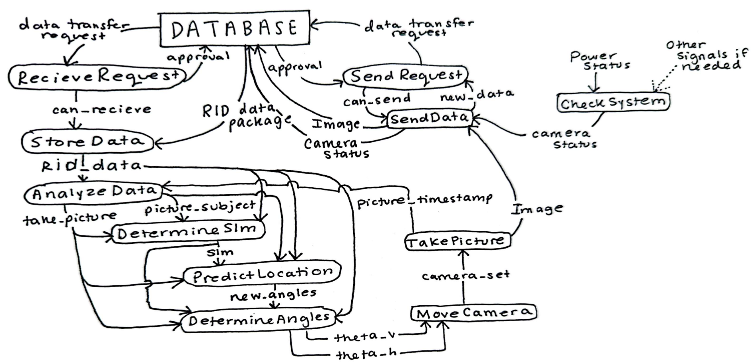
Who am I and what did I do?
Team 1 Drone Tracker Project
it tracks drones…
Camera Software Subsystem
Primarily responsible for aligning the camera and interfacing with the database.

Slide 4
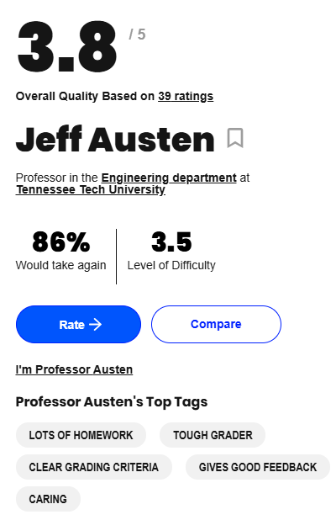
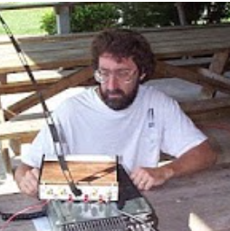
My Reflections
The Good...
I liked my project and advisor.

Slide 5
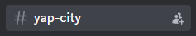
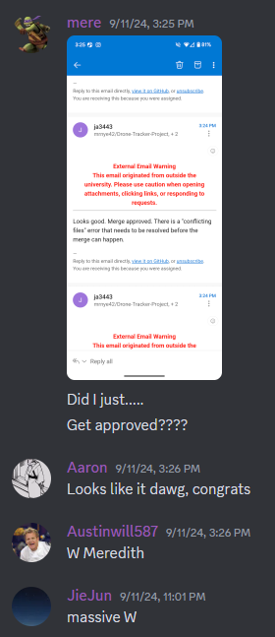
My Reflections
The Good...
I liked my project and advisor.
My subsystem completed most milestones.
I enjoyed working with my team. (very supportive)

Slide 6
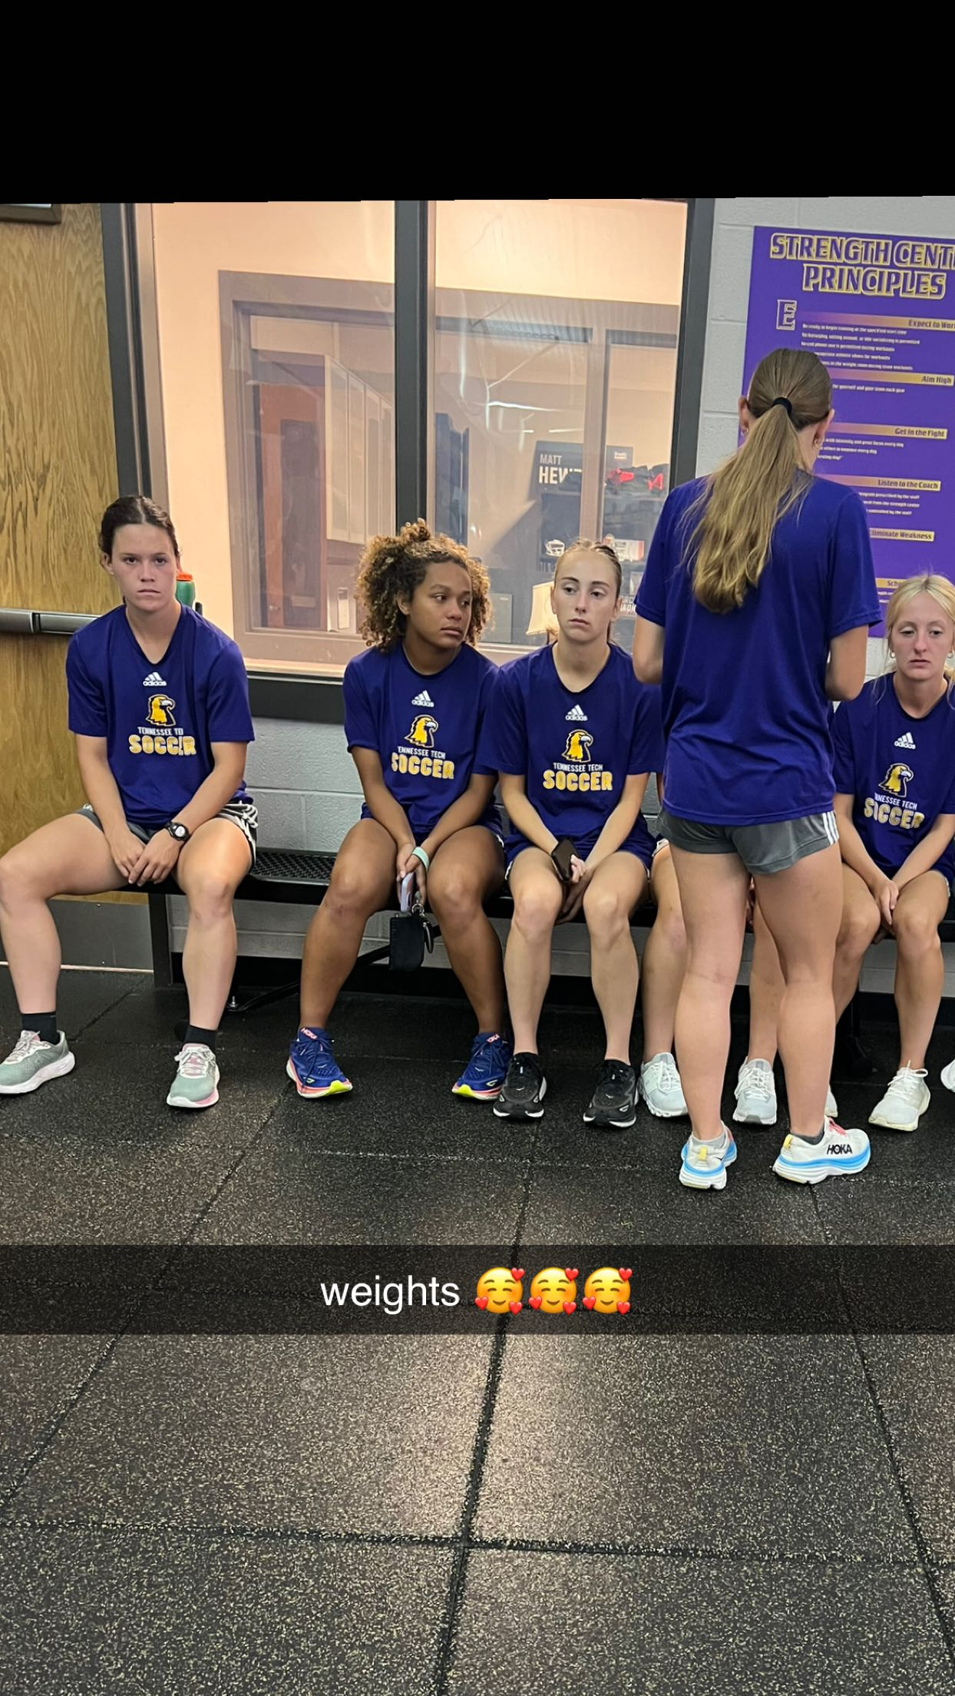
My Reflections
The Good...
I liked my project and advisor.
My subsystem completed most milestones.
I enjoyed working with my team. (very supportive)
The Bad…
The process was tiring and stressful at times.
Work, school, and soccer from 5 a.m. -> 11 p.m. some days

Slide 7
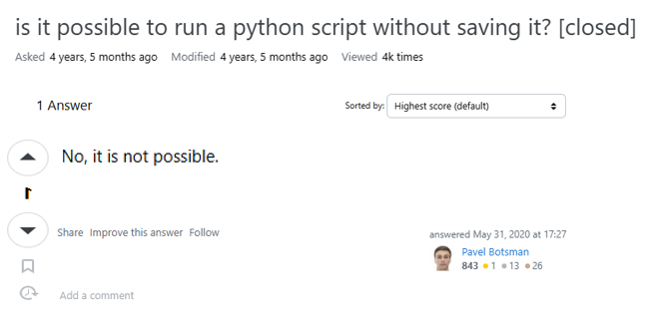
My Reflections
Unanticipated issues:
The team got a little behind sometimes.
I had no idea what I was doing. (my coding experience was very limited)
4 hours wasted ☺

Slide 8
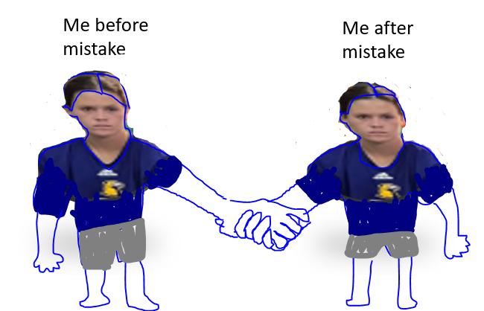
My Reflections
What would I do differently?
Accept that being wrong is okay.
Struggles and mistakes are precursors to growth.
Get rid of the inferiority complex.
Hour 1
Hour 4

Slide 9
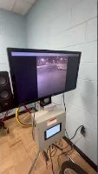
My Reflections
Best Practices:
Communicate early and often. (Good for teams and relationships)
Talk to people that have done this before
Heed their advice

Slide 10





What did I learn?
GitHub + Overleaf
Raspberry Pi
How to code again
Design process

Slide 11
Words of Wisdom
Your team and project make a difference. Choose thoughtfully.
Murphy will be on your design team.
–Dr. Bruce

Slide 12
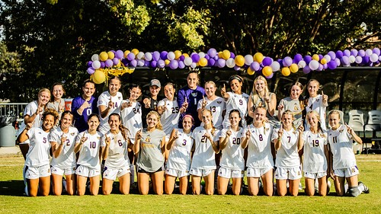
Questions and Feedback

